Slide 1
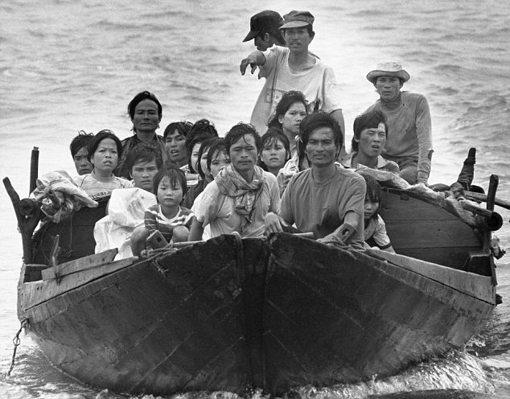
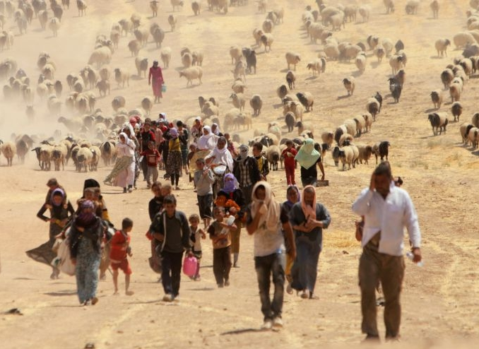
Mass Migration or Refugee Crisis?
Nat Geo Historical Migration Examples

Slide 2
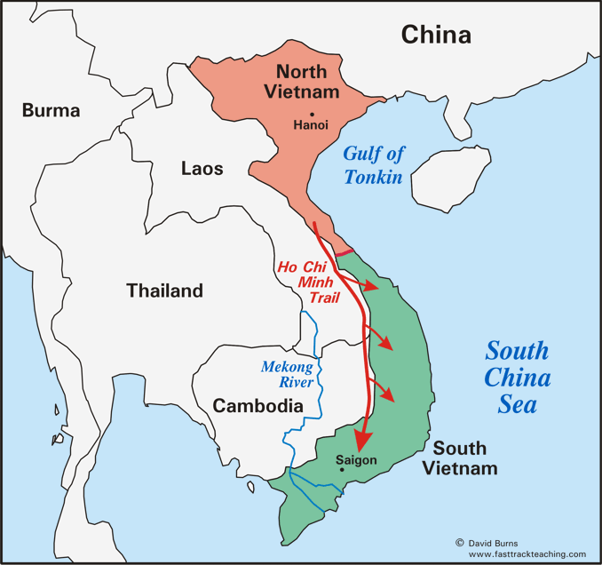
Vietnamese “Boat People”
WHO?
Migrated: Vietnamese people
Caused Migration: Communist N. Vietnamese government
WHEN?
1975- late 1980’s
Notes:
Thailand, Malaysia, Singapore, Hong Kong
Japan + Australia

Slide 3
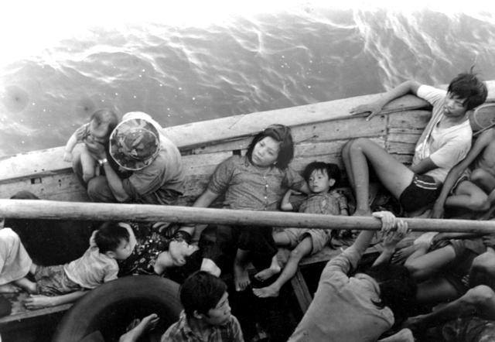
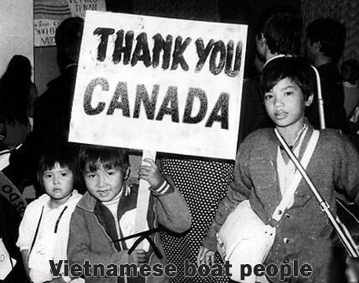
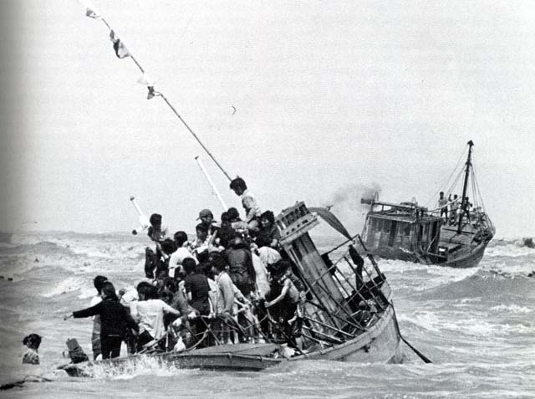

Slide 4
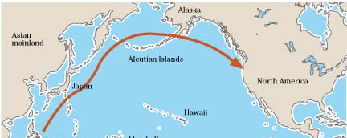
Vietnamese “Boat People” (cont.)
WHERE?
Origin: Vietnam
Destination(s):
SE Asian countries (1st)
Western Europe & N. America (2nd)
Notes:
Thailand, Malaysia, Singapore, Hong Kong
Japan + Australia

Slide 5
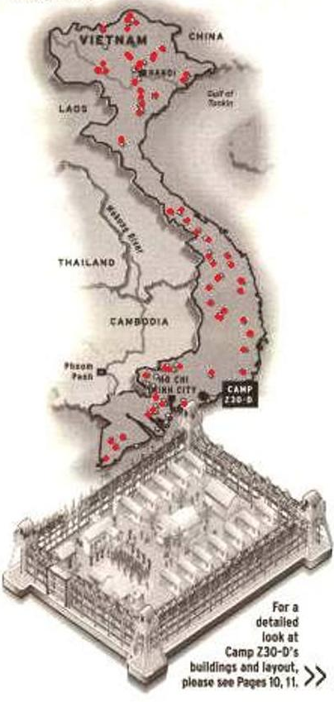
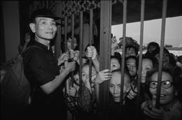
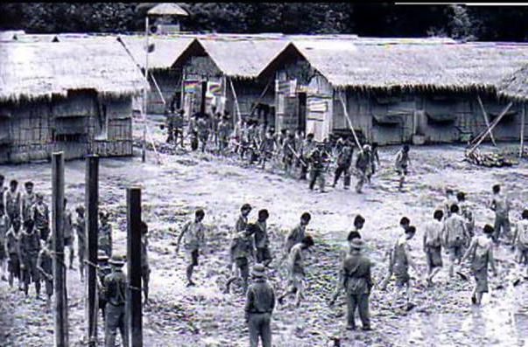
Vietnamese “Boat People” (cont.)
WHY?
Economic & Cultural Push Factors:
war
poverty
political oppression
ethnic discrimination
torture

Slide 6
https://www.youtube.com/watch?v=xFkB_IlWZHY
Notes:
https://www.youtube.com/watch?v=xFkB_IlWZHY

Slide 7
African American Great Migration
WHEN?
1st Migration: 1900-1920’s
2nd Migration: 1940’s- 1970’s
WHO?
Migrated: African Americans

Slide 8
African American Migration (cont.)
WHERE?
Origin: U.S. South
Destination(s): Large cities in
East Coast
Great Lakes region
West Coast

Slide 9
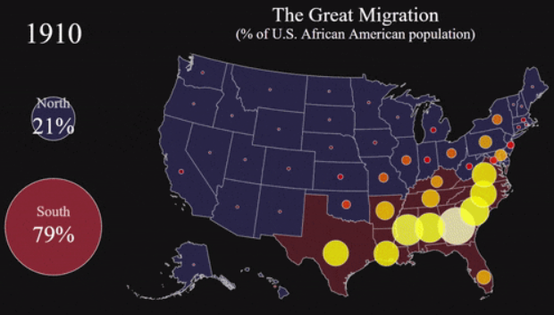
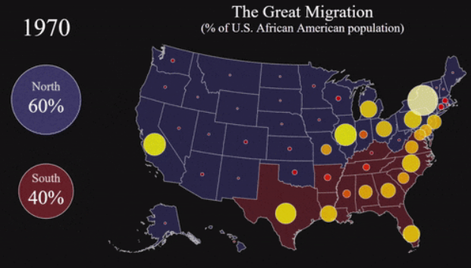
http://i1.wp.com/metrocosm.com/wp-content/uploads/2016/07/the-great-migration-map.gif

Slide 10
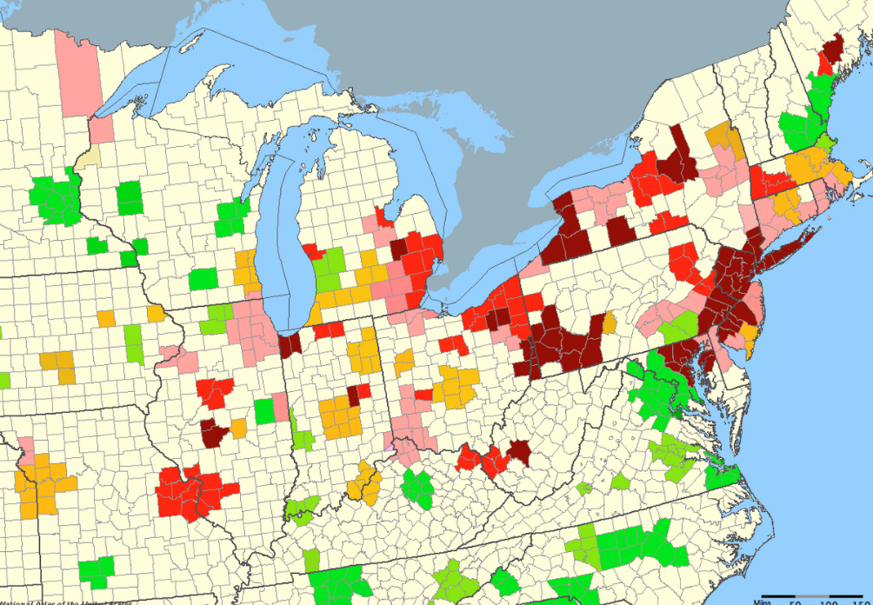
African American Migration (cont.)
WHY?
Economic & Cultural Push Factors:
Jim Crow Laws (segregation) in south
Economic & Cultural Pull Factors:
Better schools for children
Factory jobs in north
Better wages in north

Slide 11
https://www.youtube.com/watch?v=VCdTyl141bA
Notes:
https://www.youtube.com/watch?v=VCdTyl141bA

Slide 12
Jewish / Palestine
WHO?
Migrated: Jewish
WHEN?
Out of Palestine:
1st century (0-999 CE)
Back to Palestine/Israel:
1930’s

Slide 13
Jewish / Palestine (cont.)
WHERE?
0-999
Origin: Palestine (now Israel)
Destination: W. Europe & C. Europe
1930’s
Origin: W. Europe & C. Europe
Destination: Palestine

Slide 14
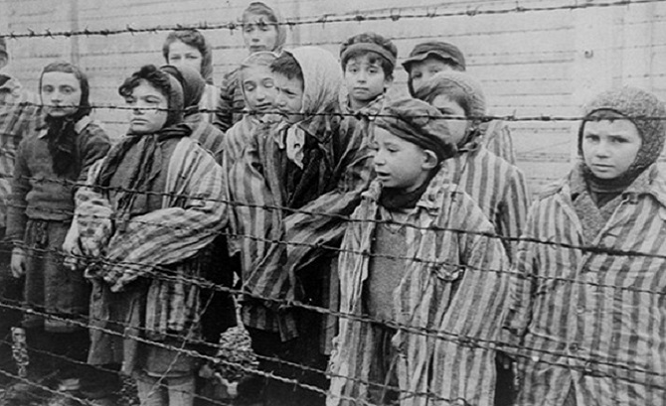
Jewish / Palestine (cont.)
WHY?
Cultural Push Factors (1930’s Europe):
Religious persecution (anti-Semitism)
Violence (Holocaust & Russian mass killings
Cultural Push Factors (1930’s Palestine):
Religious discrimination (Muslim & Christian)
Israel was created in 1948, after WWII and was declared a Jewish state – but tension between Jewish & other religions remain

Slide 15
https://www.youtube.com/watch?v=AUaU18d6-ZY
Notes:
https://www.youtube.com/watch?v=AUaU18d6-ZY

Slide 16
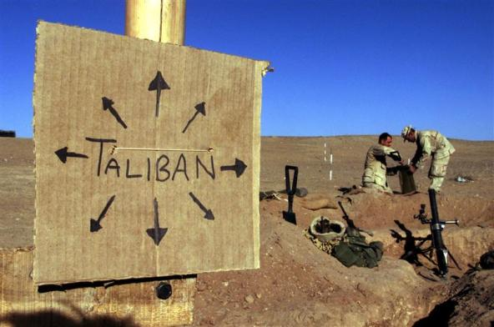
Afghan Migration
WHO?
Migrated: Afghani
Caused Migration:
USSR (soviet union) invasion
Taliban (Islamic extremist gov.)
Afghan Rebels
WHEN?
1979-early 2000’s

Slide 17
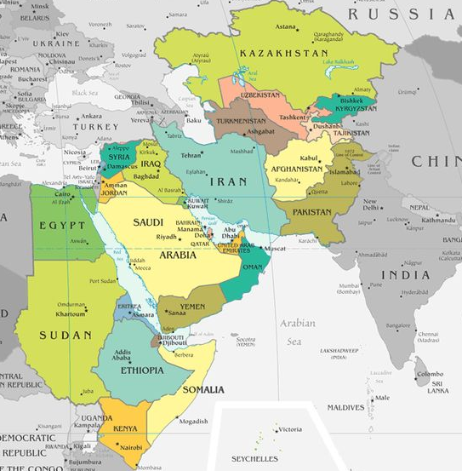
Afghan Migration (cont.)
WHERE?
From Afghanistan to…
1979: Mostly internal rural to urban, Pakistan & Iran
1989: Russia & India
1994: Canada, Australia, W. Europe, & U.S.
2002- now: Mostly internal urban to rural

Slide 18
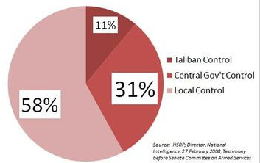
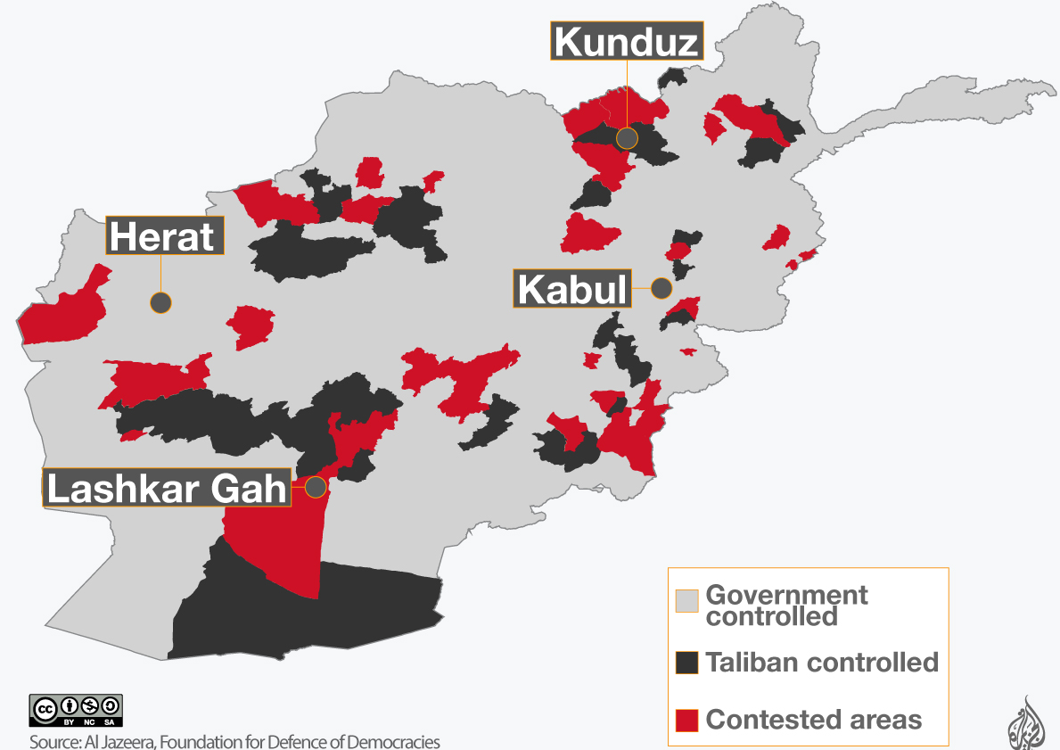
Afghan Migration (cont.)
PUSH/PULL FACTORS:
1979: Political oppression & USSR (Soviet) Invasion of Afghanistan
1989: Internal civil war (caused by USSR withdrawl)
1994: Religious and political oppression & Taliban “government” takeover
2002- now: Political oppression & Afghan rebels “government” takeover

Slide 19
Romani “Gypsies”
WHO?
Migrated: Romani People (north India)
Caused Migration:
1000’s: Invasion of Afghan general
Various groups/countries in western Europe
WHEN?
1000’s- 2015

Slide 20
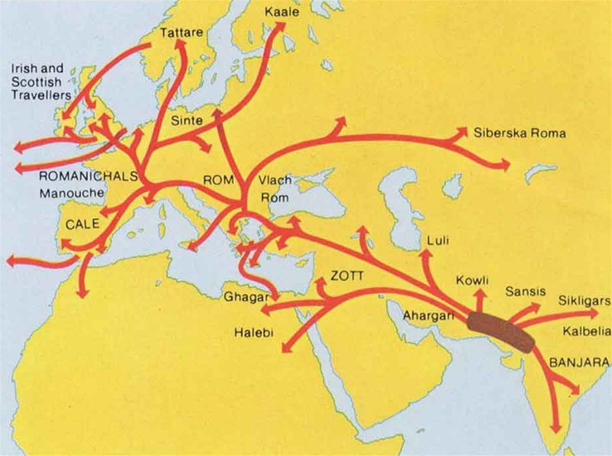
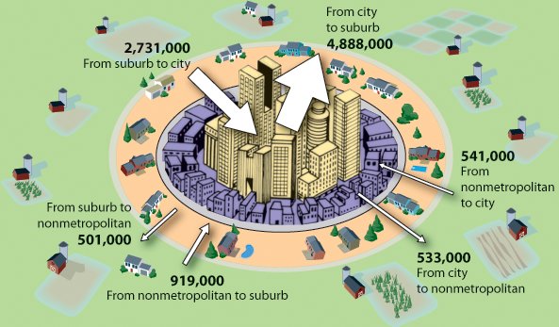
Romani (cont.)
WHERE?
1000’s: N. India to W Europe
1900’s-2000’s: Intra-regional & International

